Slide 1

FictionalTelecom
Customer Summary
and
Behavioral Overview
Prepared by:
Matt Samelson

Slide 2
Key Points
Most FictionalTelecom prepaid services customers are marginal users.
The account base is comprised of users who are longstanding account holders but generally make little use of services.
Low calling, sms, and data usage translates to low account balances, spending, and revenue generation.
A small number of « power users » exist that may be heavily active in calls, sms, and/or data usage.
A substantial revenue opportunity exists in the upscaling of marginal users through targeted marketing campaigns, changes in cost structure, or other strategies/tactics that result in increased service use.

Slide 3
Customer Base Overview
August, 2013
Customer Base | 66,469
Tenure | 892 days (median)
Account Balance | $5.40 (median)
Spending | $2.10 (median)
Customer Reloads Account | 35,561 (55%)
Customers with Outgoing Calls | 59,638 (90%)
Number of Outgoing Calls | 17 (median)
Customers with Outgoing SMS | 41,628 (63%)
Customers using Data | 3,409 (5%)

Slide 4
Customer Behavior
Most customers use FictionalTelecom services minimally if they use the services at all.
Most customers maintain an account for marginal use.
  The make few calls, send/receive few sms, and utilize little data in a given period
  They maintain low balances, recharge infrequently, and spend little in a given period.
An extreme minority of customers are high-volume users.
  They make many calls, send /receive many sms, or and/or use large amounts of data.
  These customers recharge more frequently and their spending are substantially higher than most other customers.
Significant revenue opportunity exists if marginal users can be upscaled through targeted marketing campaigns and changes in cost structure.

Slide 5
Outgoing Calls: 17 (median)
Spending on Outgoing Calls: $.84 (median)
Duration: 7.45 minutes (median)
Inactivity: 2 days (median)
Calls
Key Figures – Aug 2013
Outgoing Calls
  81% made fewer than 50 calls
  98% made fewer than 200 calls
Spending
  52% spent less than $1 on outgoing calls
  95% spent less than $20 on outgoing calls.
Duration
  32% of calls were for less than 1 minute
  82% of calls were for less than 50 minutes
Inactivity
  37% of customers were inactive for one day or less
  85% of customers were inactive for 10 days or less

Slide 6
Outgoing SMS: 4 (median)
Incoming SMS: 2 (median)
Spending on Outgoing SMS: $.12 (median)
Inactivity: 3 days (median)
SMS
Key Figures – Aug 2013
Outgoing SMS
  60% sent fewer than 10 outgoing messages
  90% sent fewer than 100 outgoing messages
Incoming SMS
  43% received fewer than 1 incoming message
  93% received fewer than 20 incoming messages
Spending
  69% spent less than $1 on outgoing messages
  98% spent less than $15 on outgoing messages
Inactivity
  26% were inactive one day or less
  57% were inactive 15 days or less

Slide 7
Connections: 0 (median)
Usage in KB: 0 (median)
Spending: $0 (median)
Inactivity: 20 days (median)
Data
Key Figures – Aug 2013
Connections
  98% had one or fewer connections
Usage
  96% used 1 KB or less data
Spending
  98% spent less than $1 on data
Inactivity
  99% were not active on a daily basis

Slide 8
Appendix
(Full Distributions for Factors Referred to in Main Body)

Slide 9
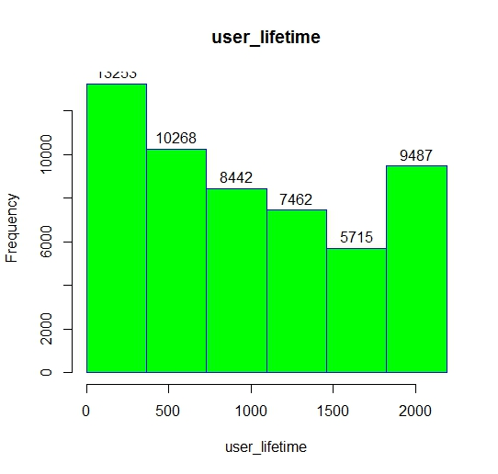
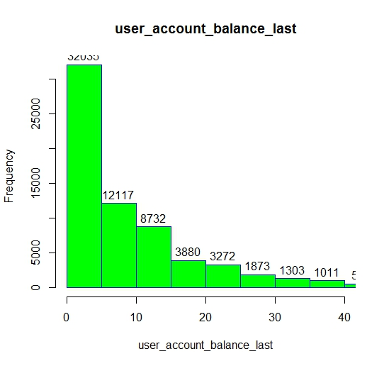
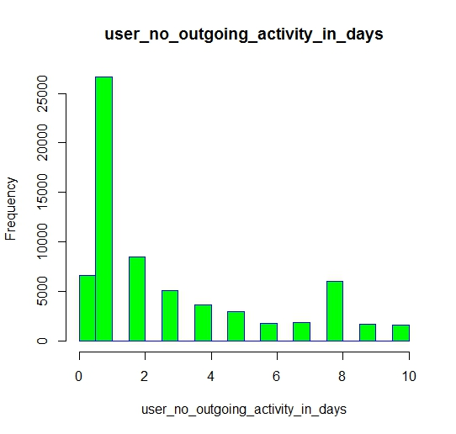
Tenure
Account Balance
Min. 1st Qu. Median Mean 3rd Qu. Max.
1.0 377.0 892.0 984.8 1529.0 2048.0
Min. 1st Qu. Median Mean 3rd Qu. Max.
0.000 0.090 5.400 9.855 13.050 1792.000
Days Inactivity
Min. 1st Qu. Median Mean 3rd Qu. Max.
0.000 1.000 1.000 2.881 4.000 10.000

Slide 10
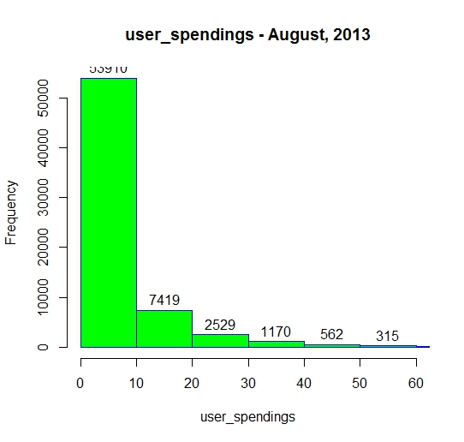
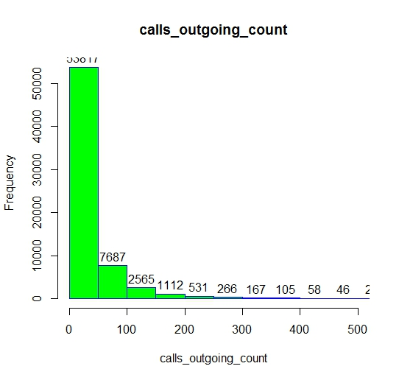
Account Balance
User Spending
Min. 1st Qu. Median Mean 3rd Qu. Max.
0.000 0.090 5.400 9.855 13.050 1792.000
Min. 1st Qu. Median Mean 3rd Qu. Max.
0.000 0.000 2.100 6.348 7.440 482.000
Outgoing Calls
Min. 1st Qu. Median Mean 3rd Qu. Max.
0.00 4.00 17.00 36.83 44.00 3698.00

Slide 11
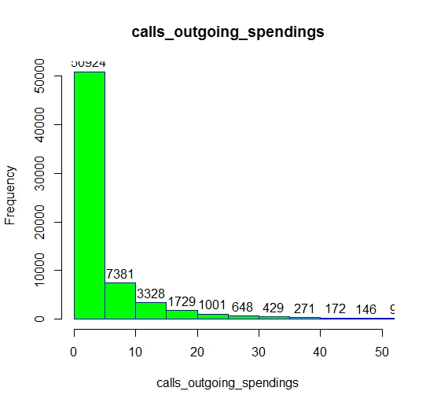
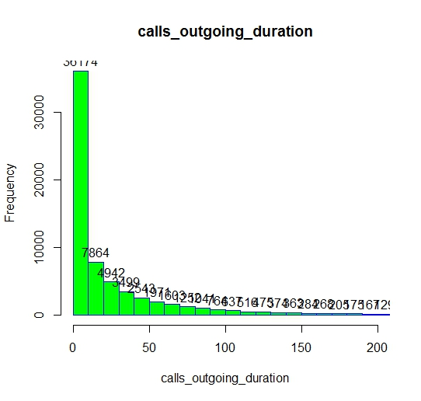
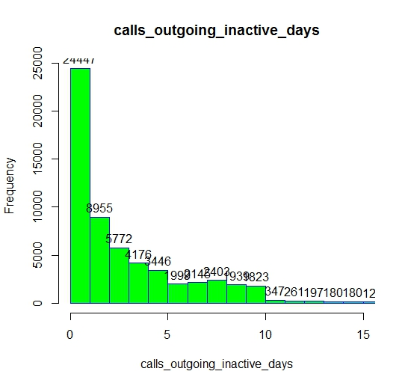
Outgoing Call Spending
Outgoing Call Duration
Min. 1st Qu. Median Mean 3rd Qu. Max.
0.000 0.000 0.840 4.281 4.540 388.200
Min. 1st Qu. Median Mean 3rd Qu. Max.
0.00 0.00 7.45 29.04 32.27 1867.00
Outgoing Calls Inactive Days
Min. 1st Qu. Median Mean 3rd Qu. Max. NA's
0.000 1.000 2.000 4.366 5.000 337.000 6107

Slide 12

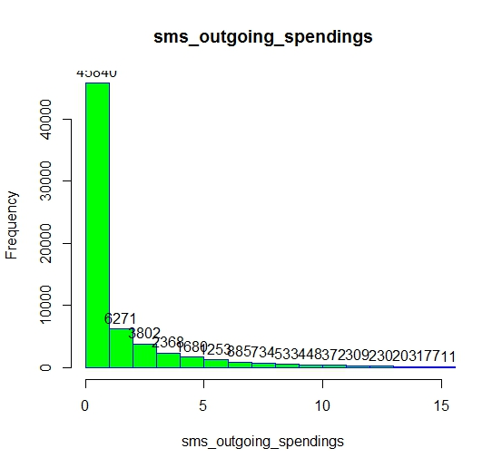
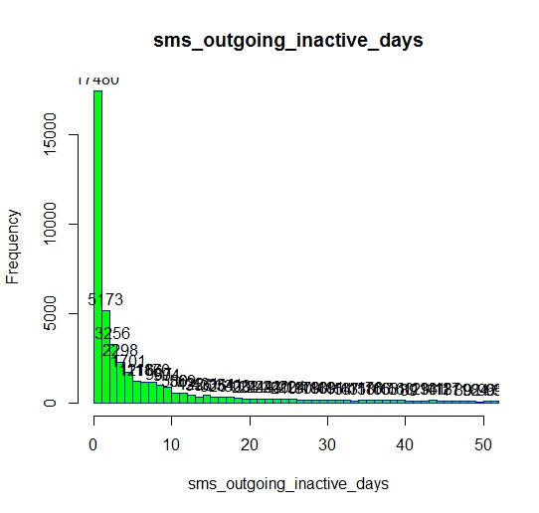
Outgoing SMS Count
SMS Spending
Min. 1st Qu. Median Mean 3rd Qu. Max. NA's
0.000 1.000 2.000 4.366 5.000 337.000 6107
Min. 1st Qu. Median Mean 3rd Qu. Max. NA's
0.000 0.000 0.120 1.854 1.590 386.500 1
SMS Outgoing Inactivity
Min. 1st Qu. Median Mean 3rd Qu. Max. NA's
0.00 1.00 3.00 11.27 11.00 337.00 19199

Slide 13
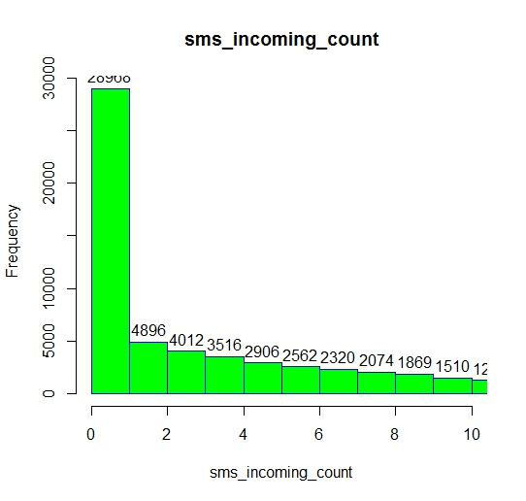
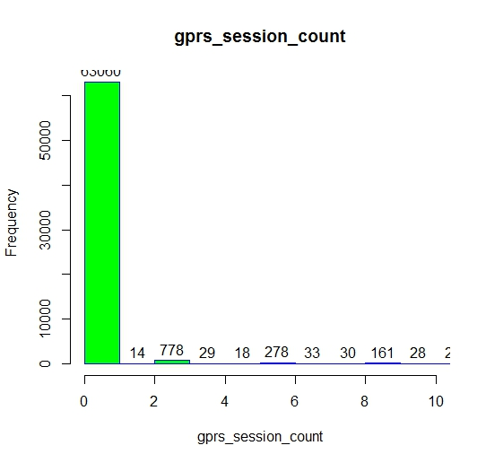
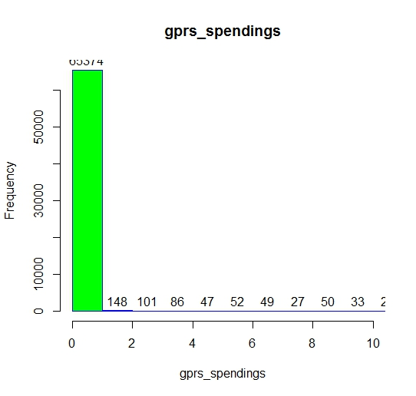
SMS Incoming Count
Data Session Count
Min. 1st Qu. Median Mean 3rd Qu. Max.
0.000 0.000 2.000 6.265 8.000 705.000
Min. 1st Qu. Median Mean 3rd Qu. Max.
0.00 0.00 0.00 13.24 0.00 16200.00
Data Spend
Min. 1st Qu. Median Mean 3rd Qu. Max. NA's
0.0000 0.0000 0.0000 0.2134 0.0000 254.4000 94

Slide 14
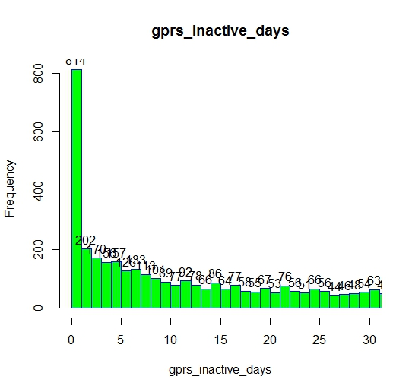
Data Inactivity
Min. 1st Qu. Median Mean 3rd Qu. Max. NA's
0.00 5.00 20.00 29.42 49.00 337.00 60950

